Slide 1
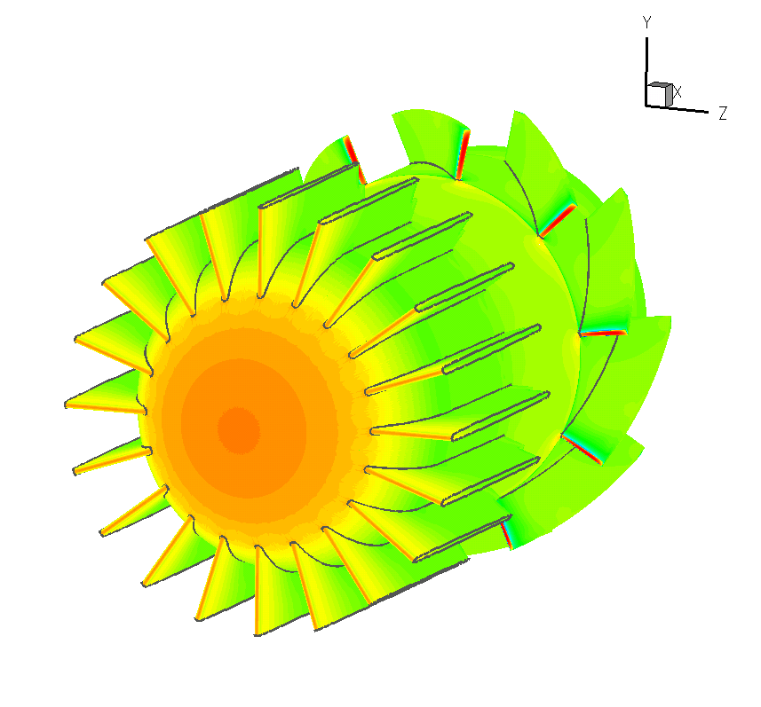
Numerical Methods
Applied to
Fluid Flow Metering
Ernst von Lavante
University of Duisburg-Essen

Slide 2
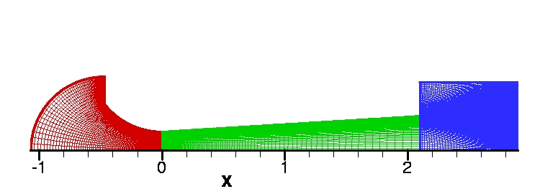
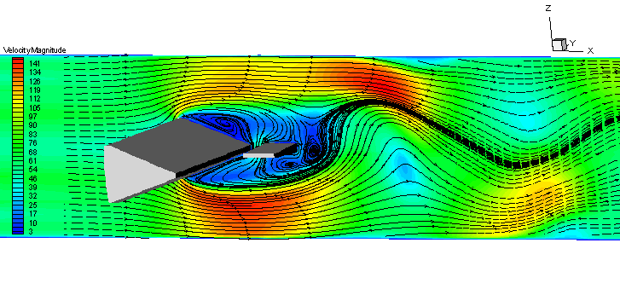
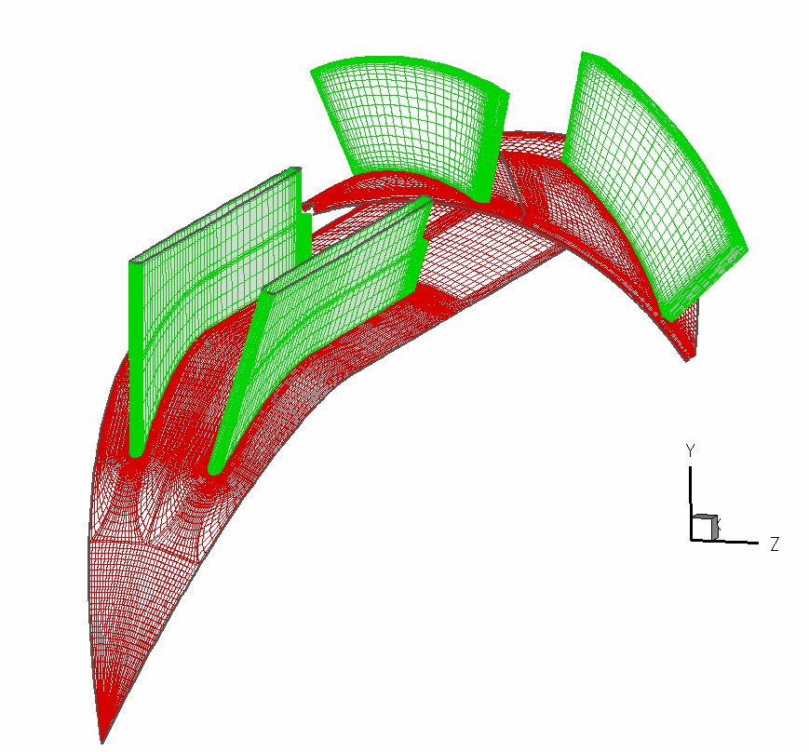
Overview
Introduction
Basics
Choice of right “tools”
Various case studies
Validation and verification
Recommendations, future work
Conclusions

Slide 3
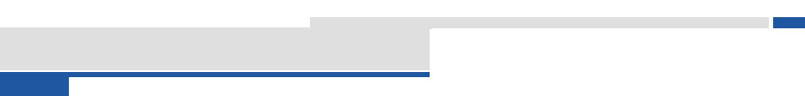
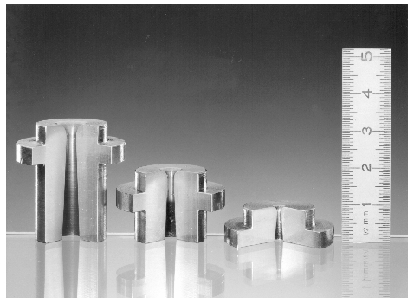
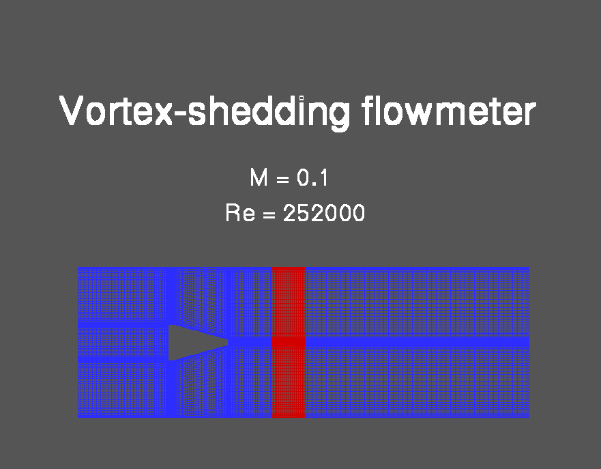
Introduction
The beginning: critical flow Venturi nozzles (CFVN)
Next configuration: vortex flow meters
And after that: turbine flow meters
ultrasonic flow meters
rotary piston flow meters
cavitation nozzles
flow straighteners
......
Goals
Problems

Slide 4
Basics
Main goal: numerical simulation of flow fields in flow metering configurations
In all cases, scale sufficiently large to give Kn = λ/L < 0.01
with λ  10⁻⁸ – 10⁻⁹ m => continuum
Notice: Kn  M/Re
a) flows with M/Re > 1 called rarefied
b) incompressible gas (M0) can not be rarefied
c) small Re flow could mean rarefied fluid
d) large Re flows are always continuum

Slide 5
Basics
Physics of the flow:
compressible (Ma ≥ 0.3) => mixed hyperbolic-parabolic, coupled
incompressible => mixed elliptic-hyperbolic-parabolic, decoupled
laminar (Re ≤ 2300 !)
turbulent => turbulence model (k-ε, k-ω, RNG, realizable, SST,
RSM, LES, DES, DNS)
steady
unsteady – periodic (deterministic) or stochastic
simulation method must have low numerical dissipation, since
μ_{Tot} = μ_{Phys} + μ_{Num} => 1/Re_{Tot} = 1/Re_{Phys} + 1/Re_{Num}

Slide 6
Basics
Considerations in numerical simulation methods (CFD):
2-D or 3-D configuration
grid generation: structured multiblock (mutigrid?)
unstructured tetrahydral, hexahydral, polyhydral
hybrid
moving (deforming) grids (adapting to flow)
overlapping grids (chimera), immersed body grids
quality of grids: smoothing, continuity, resolution in time and space
Computation: time and space accuracy, damping
Boundary conditions
Multiprozessing (parallel processing)

Slide 7
Basics
Choice of correct tools:
hardware (minimum requirements)
competence of staff
Software: system
preprocessing (grid generation)
simulation system (CFX, Fluent, adapco Star CCM+, my own programs ACHIEVE, trace,
Flower, ….)
postprocessing (included, Tecplot, …)
The correct choice will „make you or break you“ !

Slide 8
Flow Straightener
Turbine Flow Meter
Vortex Flow Meter
Coriolis-meter
Venturi Tube
Fluid Flow Meter
Critical Flow Nozzle
Rotary Piston
Meter

Slide 9
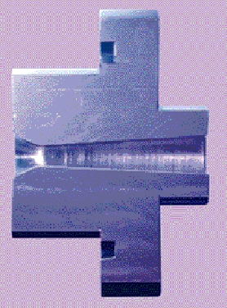
CFVN 1 - ISO
Shape: ISO 9300, toroidal version
different Reynolds numbers and pressure ratios
2-D axisymmetric, 3 blocks, structured, laminar
Notes:
9

Slide 10
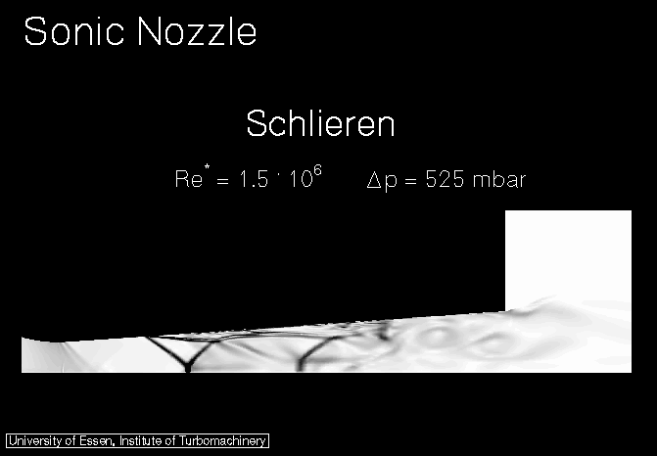
CFVN 1 - ISO
Resulting Flow, Movies, Re=1.5 10⁶
Notes:
10

Slide 11
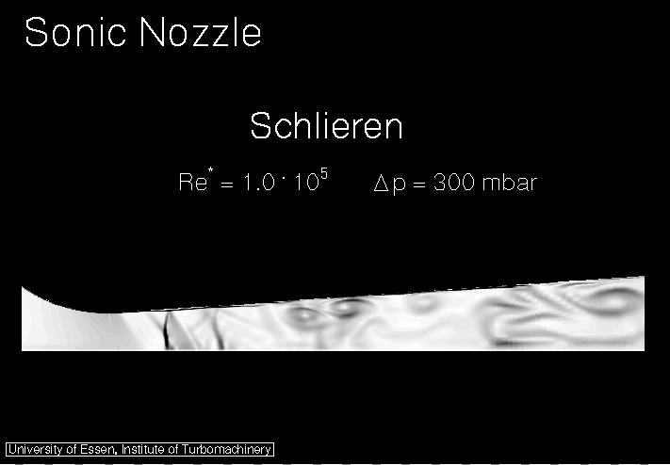
CFVN 1 - ISO
Resulting Flow, Movies, Re=0.1 10⁶
Notes:
11

Slide 12
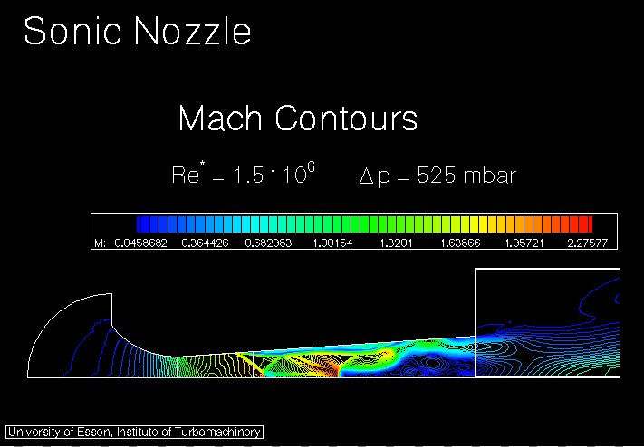
CFVN 1 - ISO
Resulting Flow, Movies, Re=1.5 10⁶
Notes:
12

Slide 13
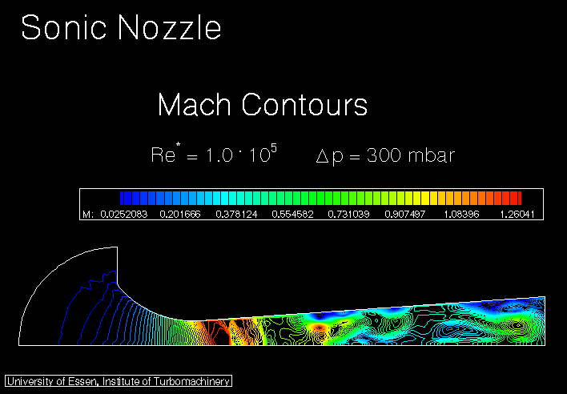
CFVN 1 - ISO
Resulting Flow, Movies, Re=0.1 10⁶
Notes:
13

Slide 14
CFVN 1 - ISO
- Unsteady effects (Elster, eon)
- Premature unchocking
- National Calibration Standard at Pigsar (Pigsar, Elster, PTB, eon)
- Real gas effects in CFVN (eon)
- Influencing of flow fields in CFVN (steps, suction)
- Micro nozzles (PTB)
- Reynolds number effects in CFVN (transition laminar-turbulent)
- Geometric factors (PTB)
- Theoretical determination discharge coeff. C_{D} (PTB)
- Shock location, influence of condenzation (NRLM)
All simulations with ACHIEVE – accuracy !!
Notes:
14

Slide 15
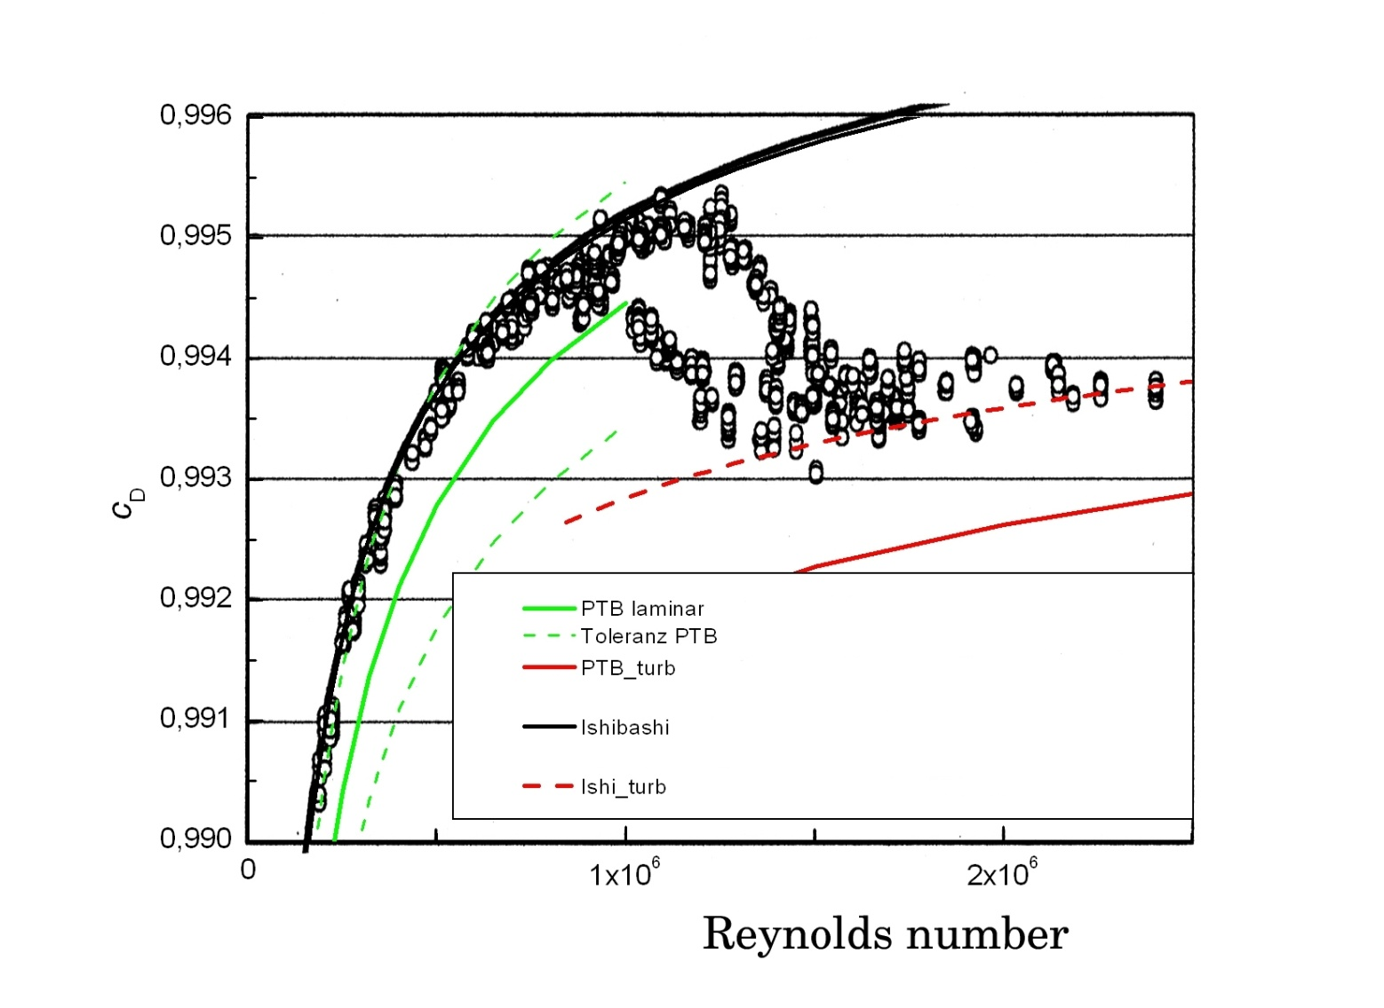
CFVN 1 - ISO
Notes:
15

Slide 16
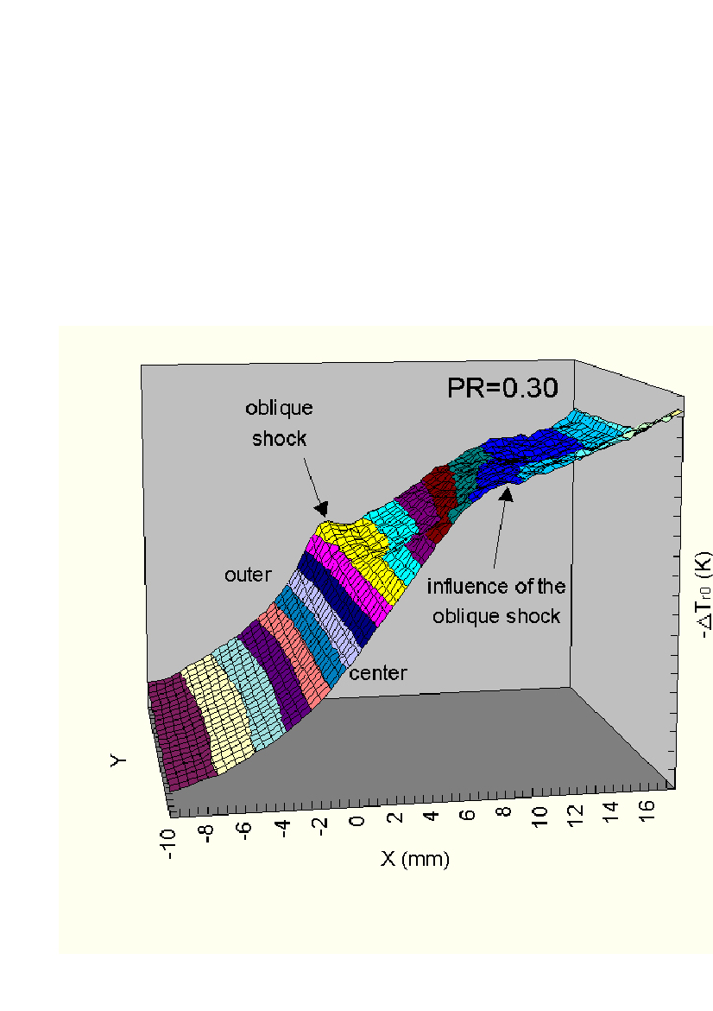
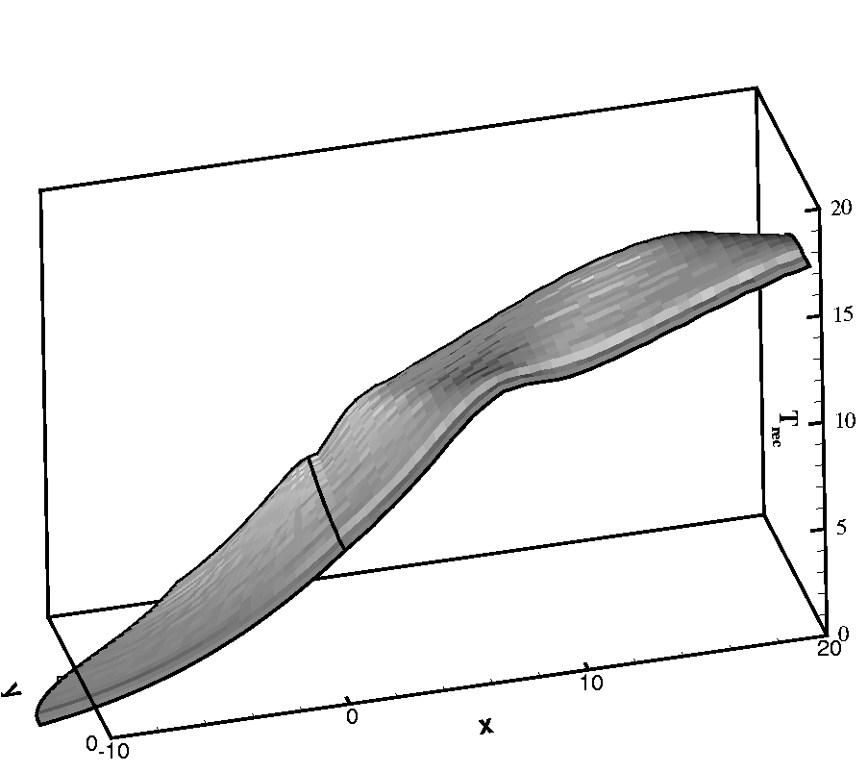
CFVN 1 - ISO
Experimental verification by Ishibashi (NRLM)
Notes:
16

Slide 17
CFVN 2 – micro nozzle
Aim of present study: comparison of high resolution CFD simulations with experimental results (PTB)
Two basic shapes: punched and drilled
Utilized in forward (L to R) and backward (R to L) orientation

Slide 18
CFVN 2 – micro nozzle
Present cases:
throat diameter D in [µm] | Reynolds-number Re_{d} | B.L. thickness δ in [µm] -> | ratio of δ/d | Knudsen number Kn
15 | 197 | 5,348 | 0,3565 | 0,0153
25 | 328 | 6,904 | 0,2762 | 0,0092
35 | 459 | 8,169 | 0,2334 | 0,0066
50 | 656 | 9,764 | 0,1953 | 0,0046
80 | 1049 | 12,351 | 0,1544 | 0,0029
In our case: Kn = 1.28 κ^{0.5} Ma/Re

Slide 19
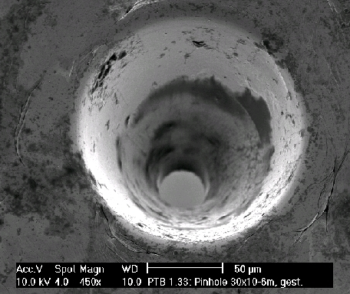
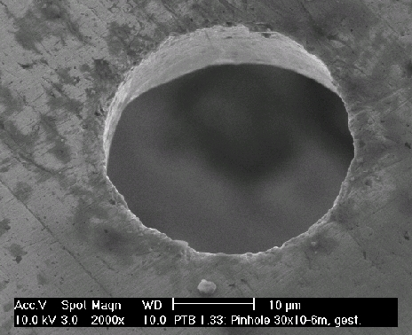
Simulation Parameter
Simulation carried out using ACHIEVE solver developed by author
Grid generated by elliptic PDE developed in house
Configuration:
D = 15, 25, 35, 50 and 80 μ , P₀ = 0.101325 MPa, T₀ = 300 K
Pressure ratios p_{out}/P₀ = 0.3 and 0.4
Notes:
19

Slide 20
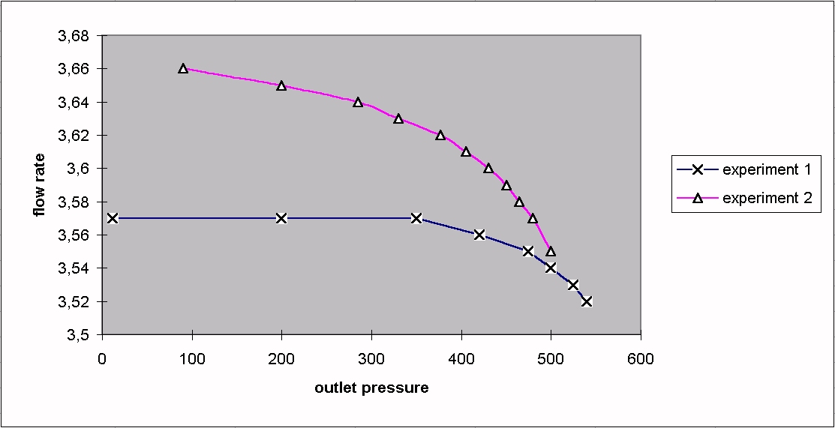
Experimental Work at PTB
Results for D = 25 µm:
Forward nozzle: choking at p/P₀ = 0.35 (ideal nozzle 0.528…)
Backward nozzle: no apparent choking
Task for numerical simulation: explain phenomenon !!
Notes:
20

Slide 21
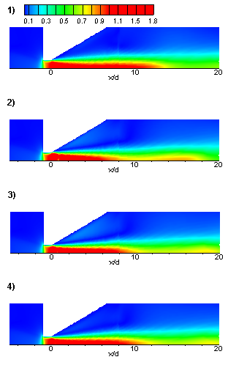
Numerical Simulations - Results
Forward orientation, p_{out}/p₀ = 0,3
Notes:
21

Slide 22
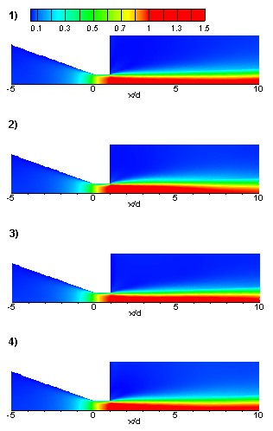
Numerical Simulations - Results
Backward orientation, p_{out}/p₀ = 0,3
Notes:
22

Slide 23
Numerical Simulations
Boundary layer in cylindrical part
p_{out}/p₀ = 0,4
Notes:
23

Slide 24
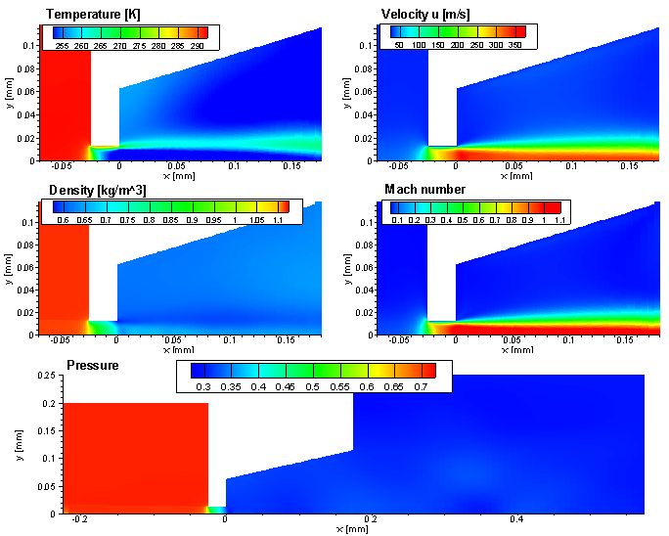
Numerical Simulations - Results
Drilled nozzle, p_{out}/p₀ = 0,3
Notes:
24

Slide 25
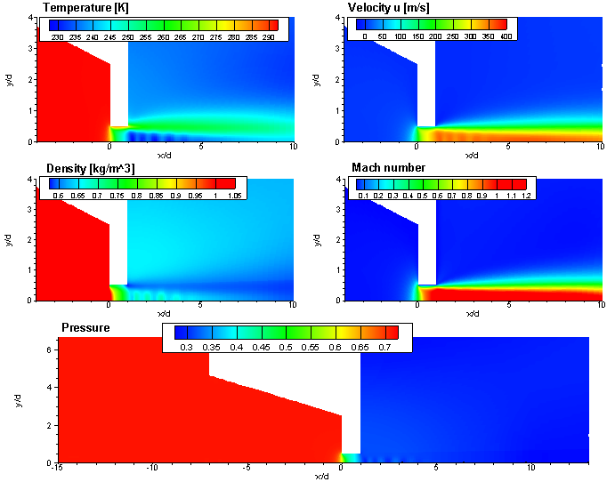
Numerical Simulations - Results
Drilled nozzle, p_{out}/p₀ = 0,3
Notes:
25

Slide 26
Summary
p₂/p₀ |  | 0,4 |  |  | 0,3
Nozzle |  | C_{d, exp} | C_{d, num} | Deviation | C_{d, exp} | C_{d, num} | Deviation
Forward | 25 | 0,662 | 0,705 | 6,45 % | 0,664 | 0,711 | 7,07 %
Backward | 25 | 0,670 | 0,707 | 5,47 % | 0,676 | 0,743 | 9,97 %
Forward Drilled | 25 | 0,660 | 0,692 | 4,90 % | 0,662 | 0,722 | 9,12 %
Backward Drilled | 25 | 0,663 | 0,697 | 4,96 % | 0,667 | 0,724 | 8,57
Back
Notes:
26

Slide 27
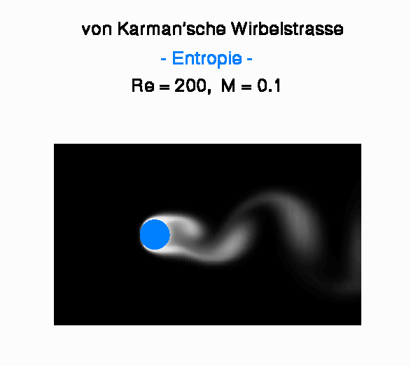
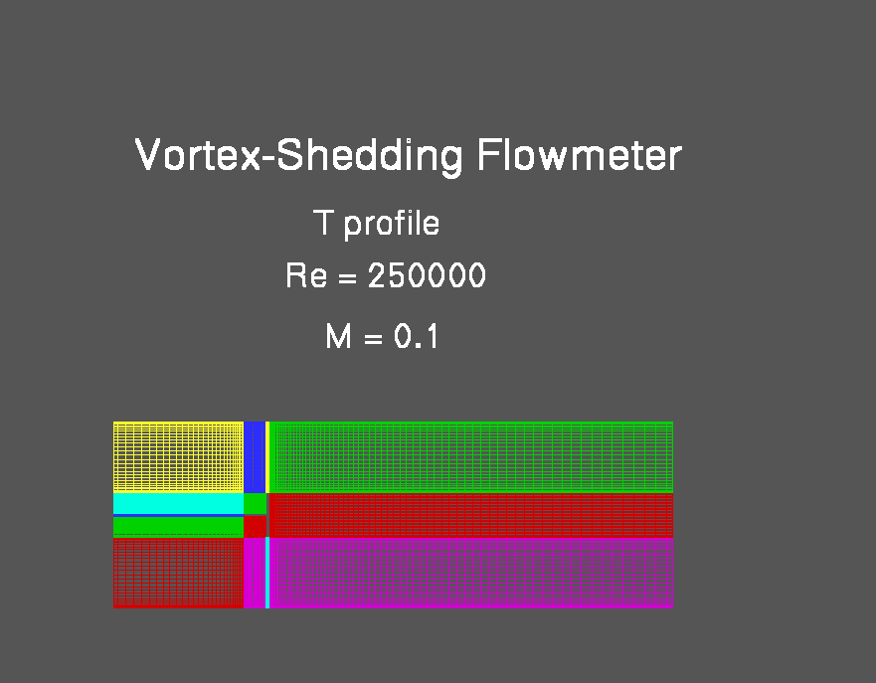
Vortex Flow Meter
Principle: von Karman vortex street; f ~ u axial
=> K-factor defined as K=f/Q should be constant
Notes:
27

Slide 28
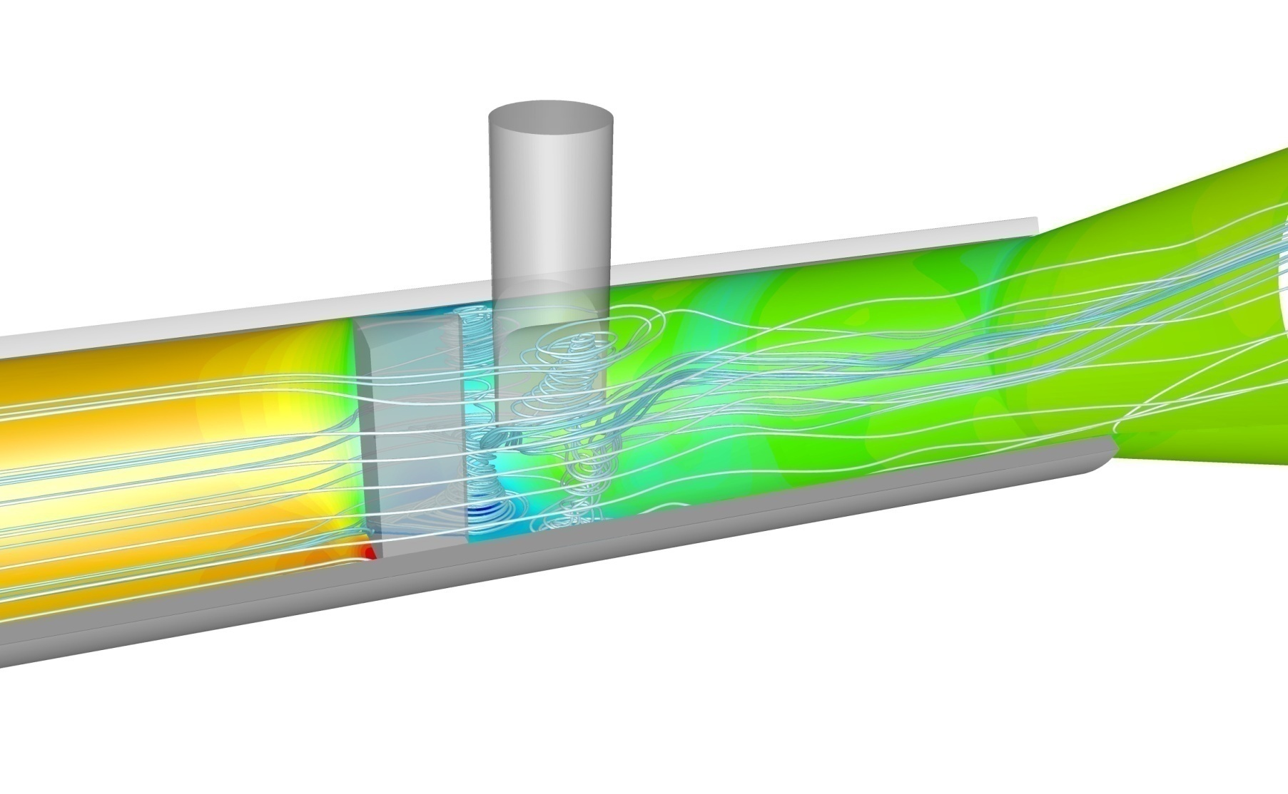
Vortex Flow Meter
Notes:
28

Slide 29
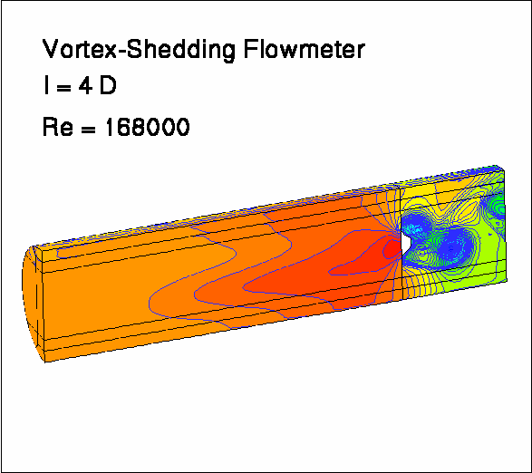
Vortex Flow Meter
Notes:
29

Slide 30
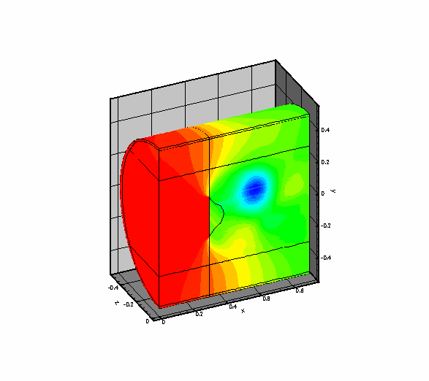
Vortex Flow Meter
Notes:
30

Slide 31
Vortex Flow Meter
- Secondary and tertiary vortices, exp. – num., (Uni-Essen)
- Pulsating flow, exp. – num., (Krohne)
- Influence of upstream disturbances (bends), exp.- num. (Krohne)
- Installation effects, bluff body and sensor, exp. – num., (ABB, Flowtec, Krohne)
- Effects of long time wear, exp. – num., (ABB, Flowtec)
- Optimization of geometry, exp. – num., (Krohne)
- Investigation of geometric flexibility (diffuser, nozzle, conical adaptor), (Krohne)
- Alternative bluff bodies (screws, rippled bodies)
- Upstream valves (butterfly, ball)
Simulations with ACHIEVE, Fluent, adapco Star-CCM+
Notes:
31

Slide 32
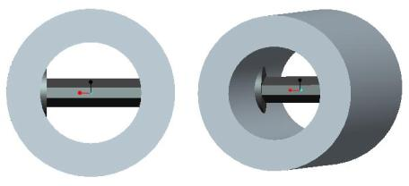
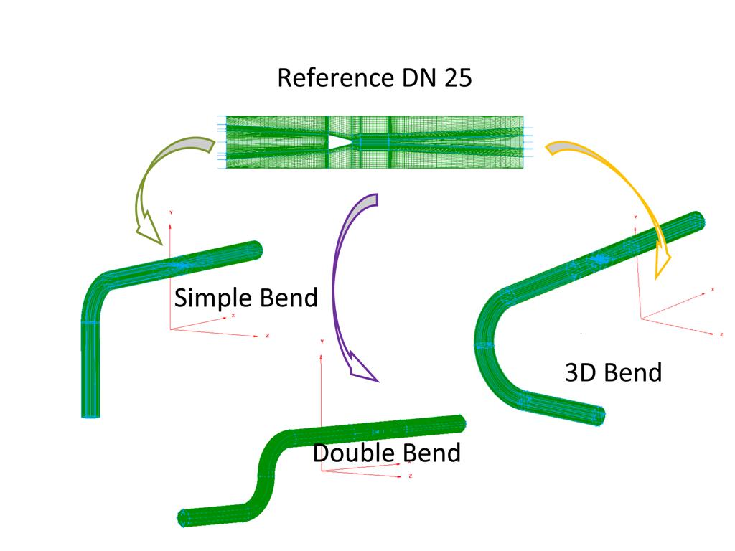
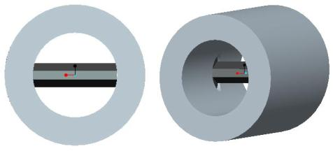
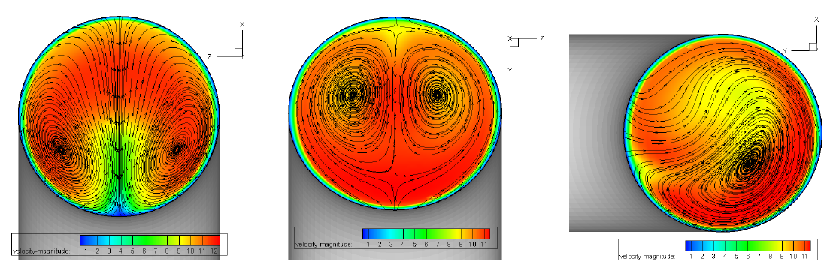
Vortex Flow Meter
Notes:
32

Slide 33
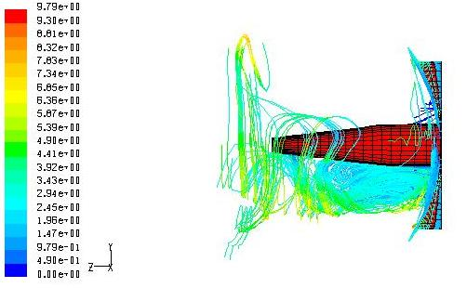
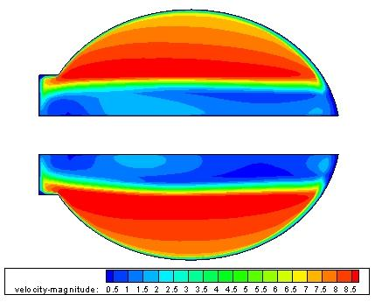
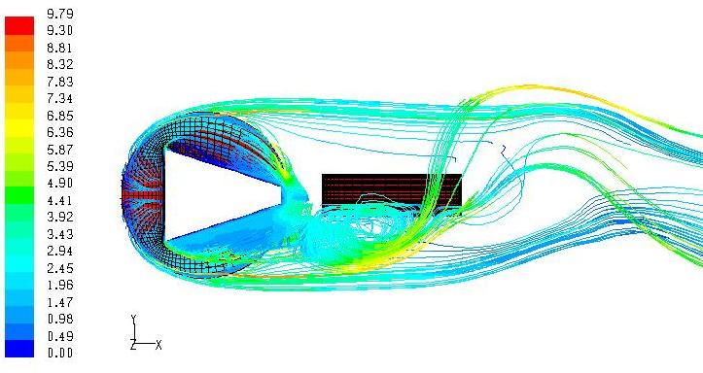
Vortex Flow Meter
Notes:
33

Slide 34
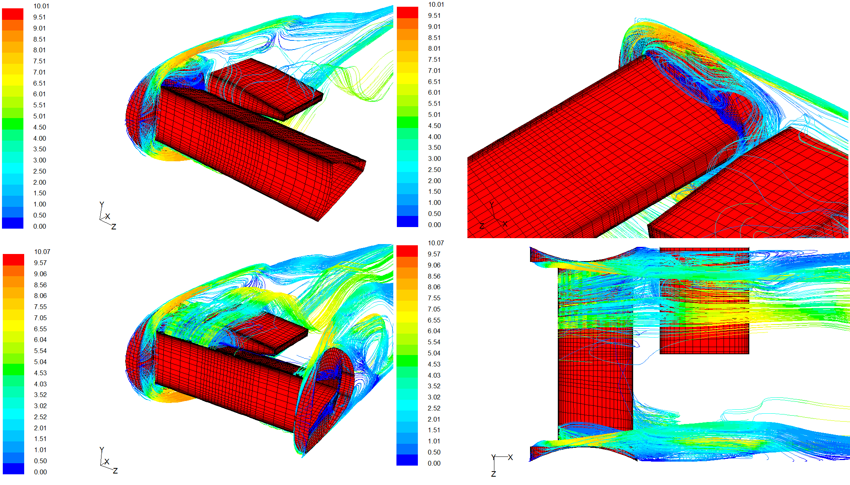
Vortex Flow Meter
Back
Notes:
34

Slide 35
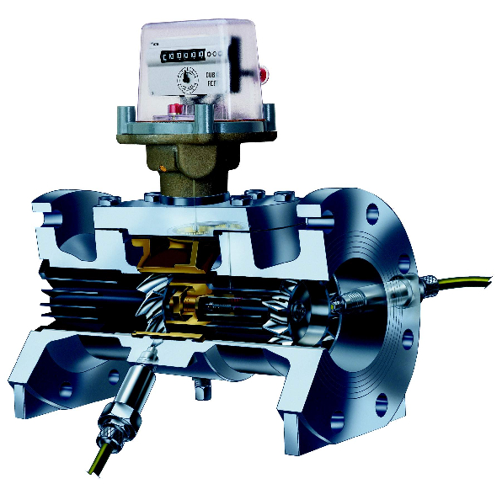
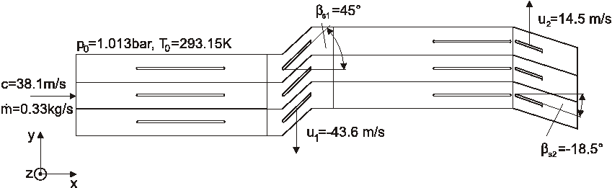
Turbine Flow Meter
Notes:
35

Slide 36
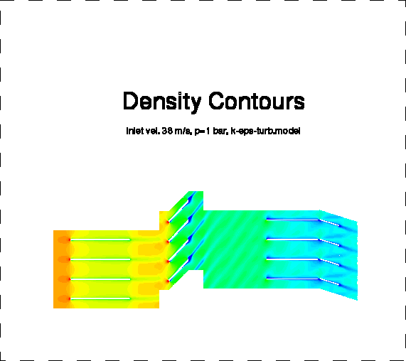
Turbine Flow Meter
Notes:
36

Slide 37
Turbine Flow Meter
- Flow field analysis (Elster)
- Q-min-effects, determination of rotational speed (Elster)
- Optimization of stator (flow straightener) (Elster)
- Development of two-stage straightener (VemmTech)
- 3-D upstream disturbances, full 360-deg. simulation (RMG)
- Investigation of laminar-turbulent transitional effects
Simulations with ACHIEVE, Fluent, adapco Star-CCM+
Notes:
37

Slide 38
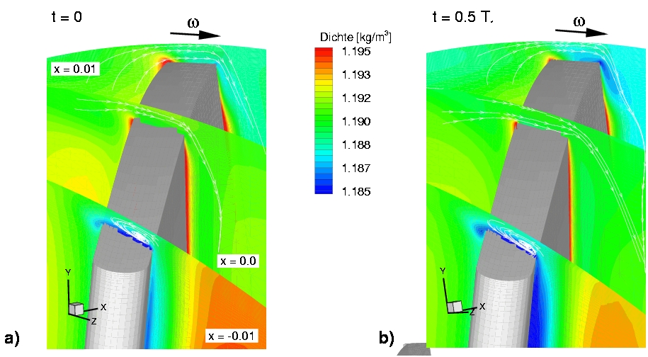
Turbine Flow Meter
Notes:
38

Slide 39
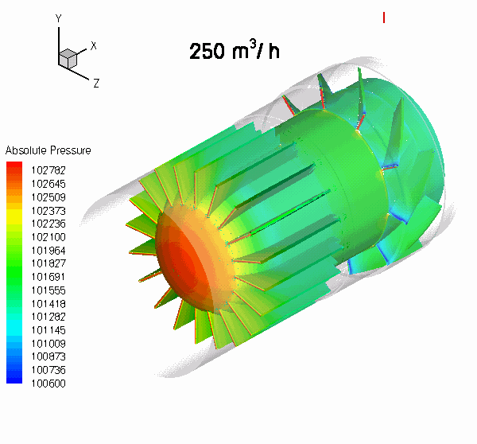
Turbine Flow Meter
Notes:
39

Slide 40
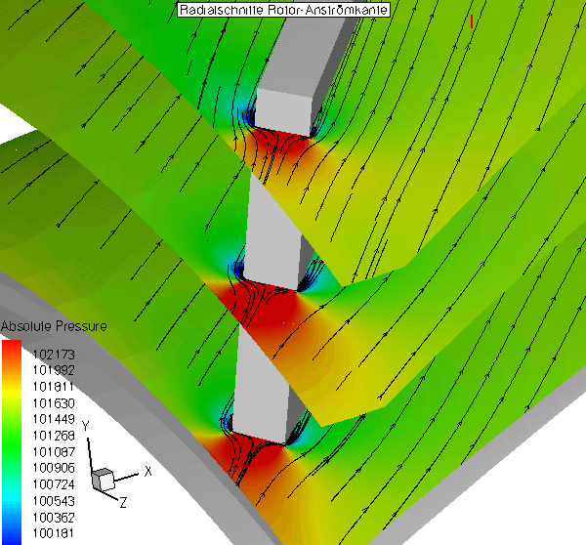
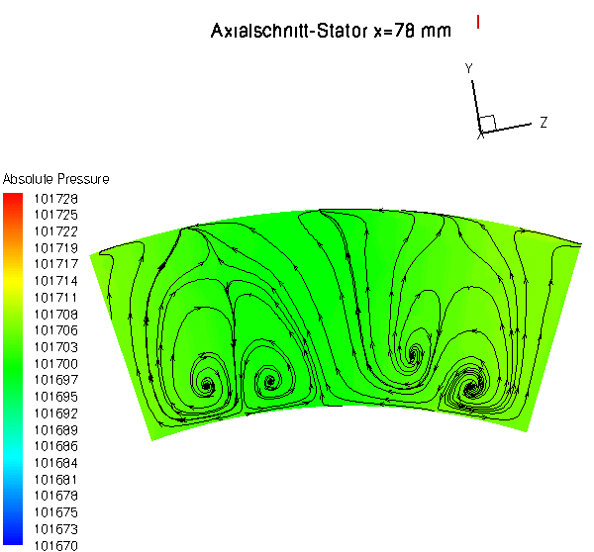
Turbine Flow Meter
Notes:
40

Slide 41
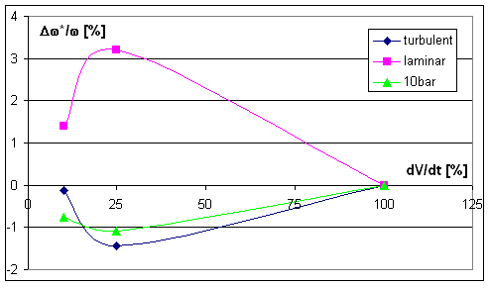
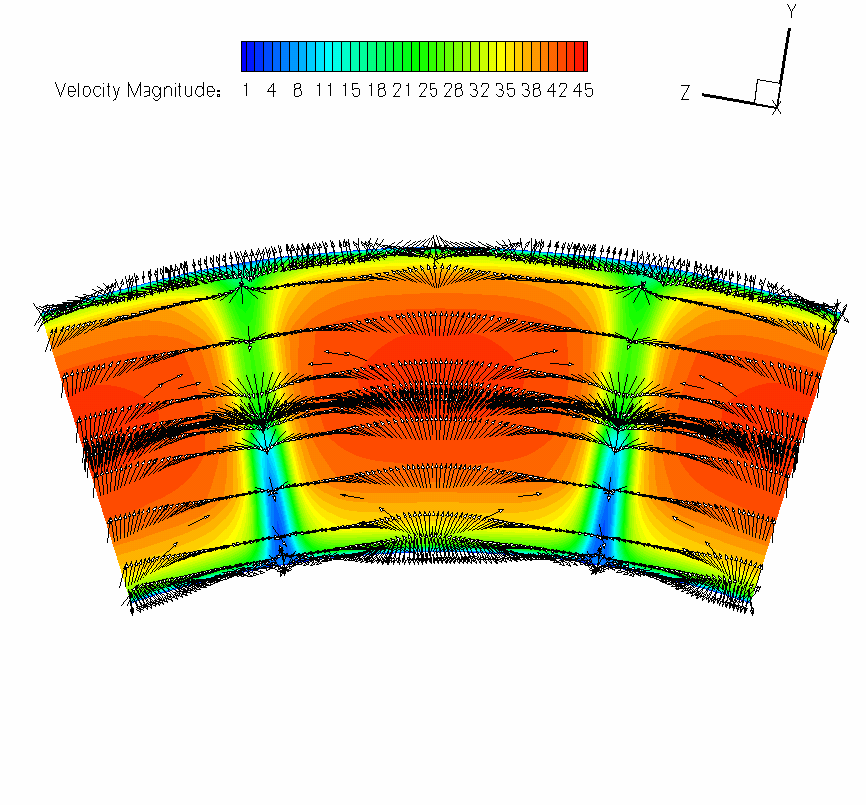
Turbine Flow Meter
Back
Notes:
41

Slide 42
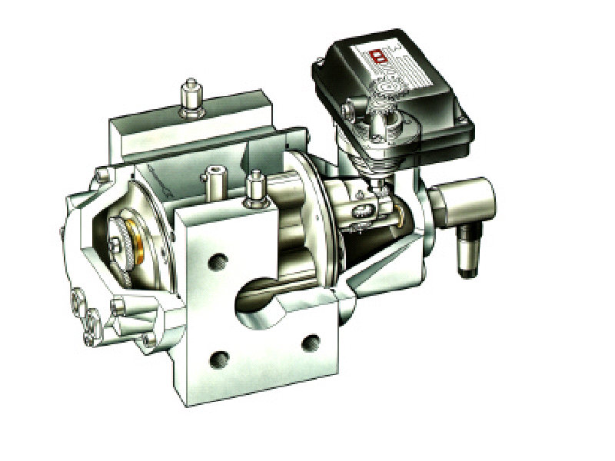
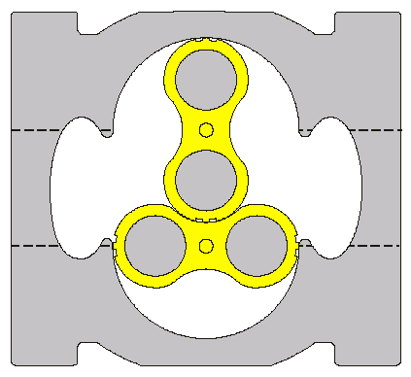
Rotary Piston Flow Meter
Motivation
Numerical investigation of the uncertainty & deviation
A) 2-D
- gap flow piston-casing
- pressure losses
- geometrical factors
- unsteady effects
B) 3-D
- unsteady solution
- flow in ind. cham.
- 3-D effects
Future Work
Notes:
42

Slide 43
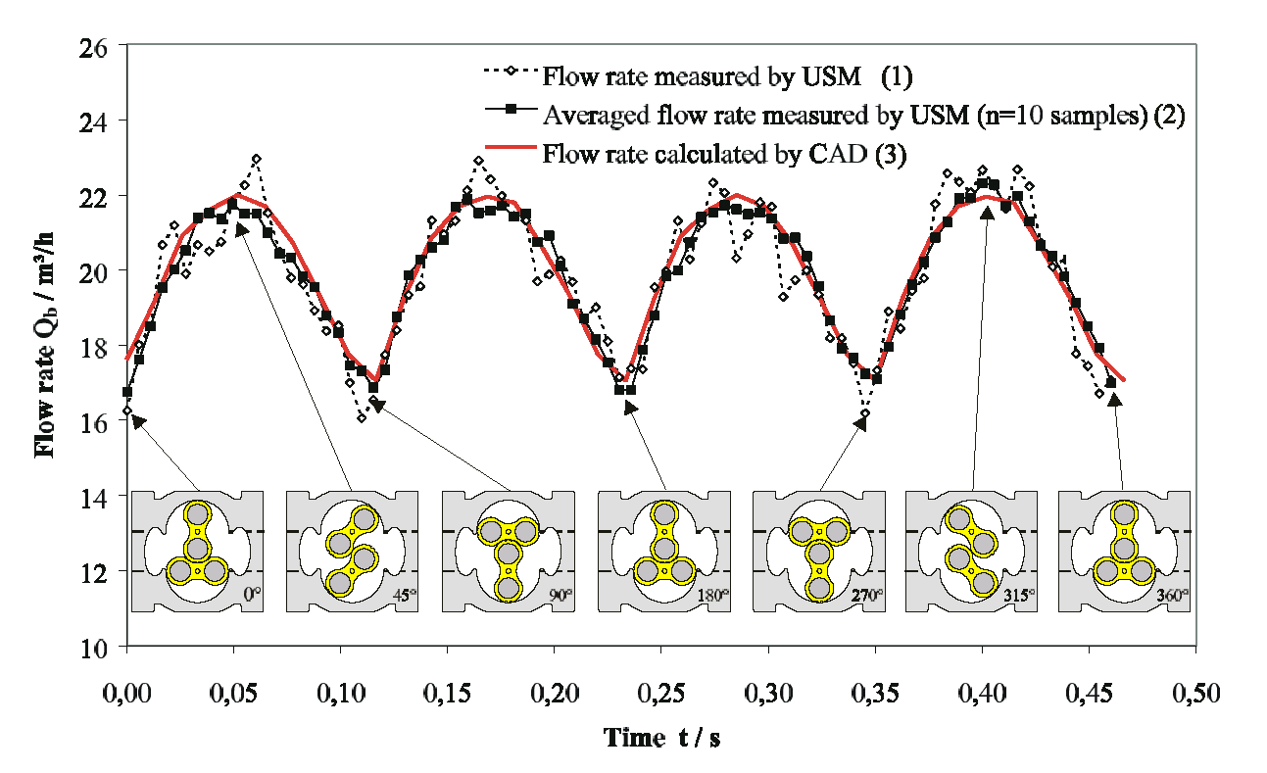
Rotary Piston Flow Meter
Notes:
43

Slide 44
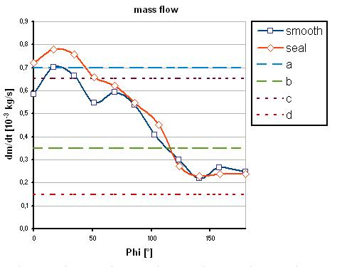
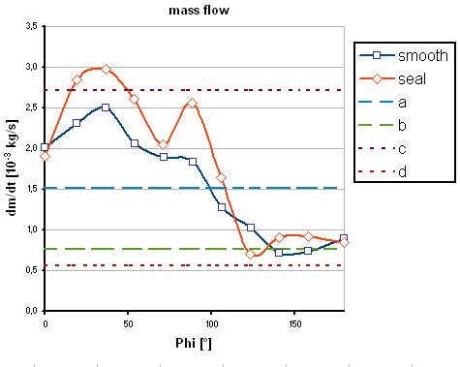
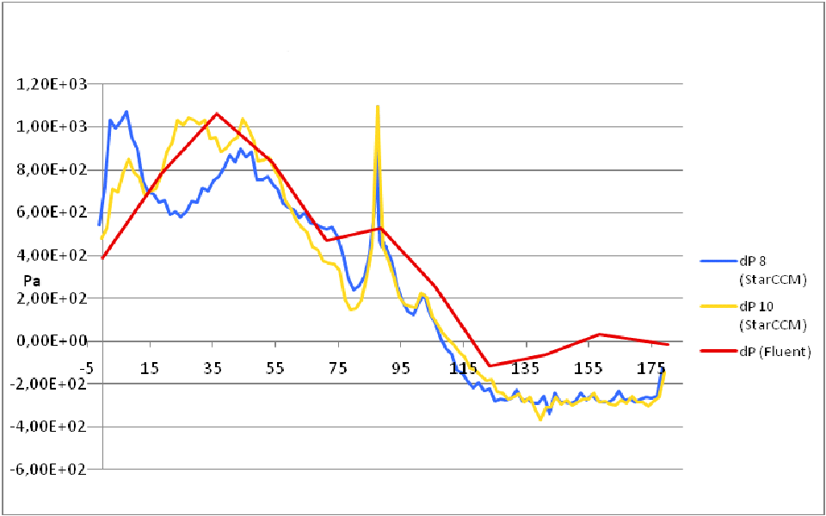
Rotary Piston Flow Meter
a) inviscid case, with constant velocity across the gap, Q = u_{w} H
b) highly viscous case with linear velocity profile, Q = ½ u_{w} H
c) case with maximum ∆p > 0
d) case with minimum ∆p < 0
Notes:
44

Slide 45

Rotary Piston Flow Meter
Notes:
45

Slide 46

Rotary Piston Flow Meter
Notes:
46

Slide 47

Rotary Piston Flow Meter
Back
Notes:
47

Slide 48
Conclusions
Reliable numerical simulation of komplex flows in flow metering configurations possible using low numerical dissipation schemes
Commercial codes should be used with care –
it is not all gold that shines
OpenFoam looks promising in many cases
Present simulations were able to provide an explanation of many flow behaviour questions
Much higher resolution simulations in future – there is never enough computer power (CPU and RAM)

